Slide 1
Maccabiah Timeline
Shabbat | Friday | Thursday | Wednesday | Tuesday | Monday | Sunday
5 | 4 | 3 | 2 | July 1 | 30 | 29
12 | 11 KABBALAT SHABBAT | 10 OPENING CEREMONY | 9 | 8 CHECK IN Welcome Gatherings | 7 | 6
19 | 18 KABBALAT SHABBAT | 17 BAR/ BAT MITZVAH | 16 | 15 | 14 | 13 17Tammuz
26 | 25 | 24 | 23 | 22 CHECK OUT LE’HITRAOT | 21 BAR/ BAT MITZVAH CLOSING CEREMONY | 20 FINALS
Pre - Camp
Pre - Camp
1

Slide 2
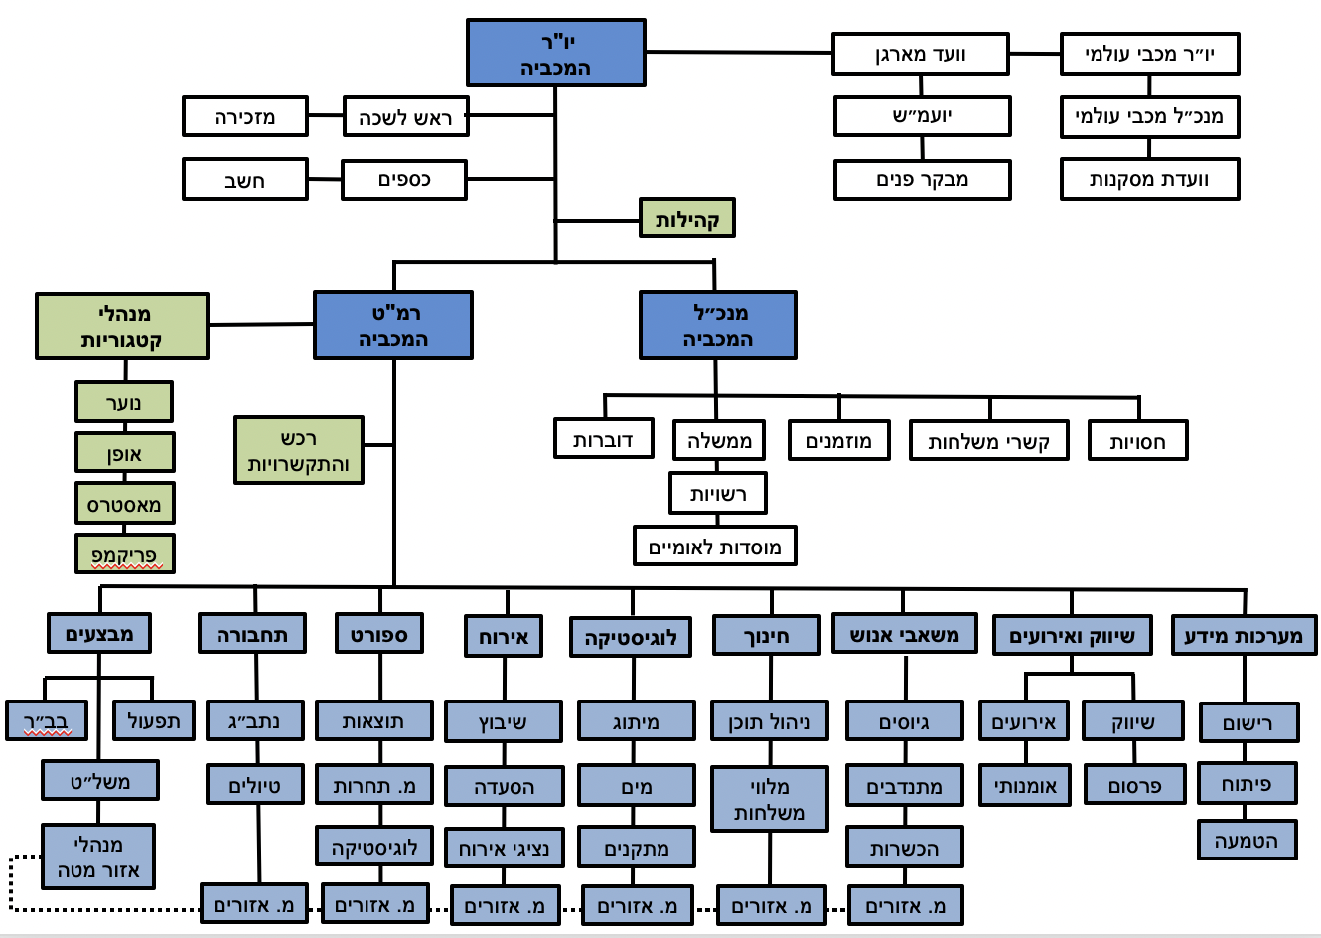
מבנה מכביה
2

Slide 3
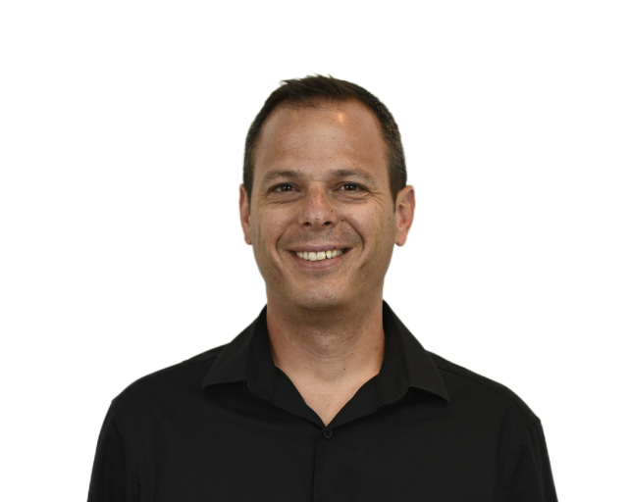
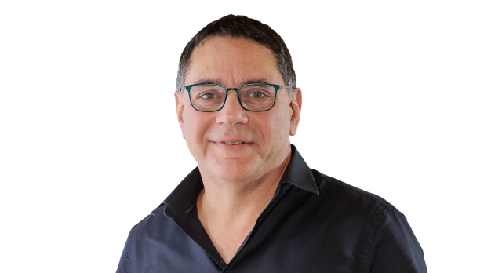
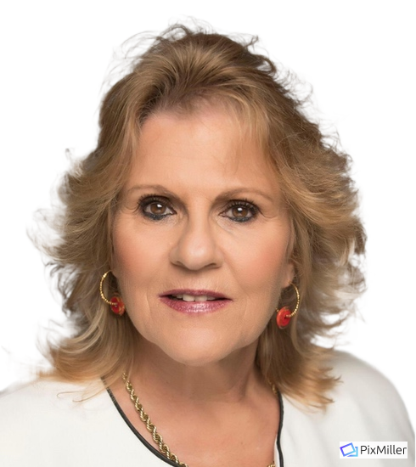
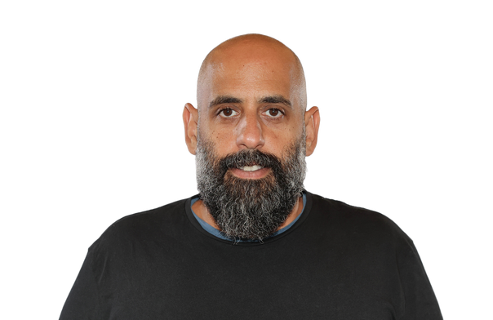
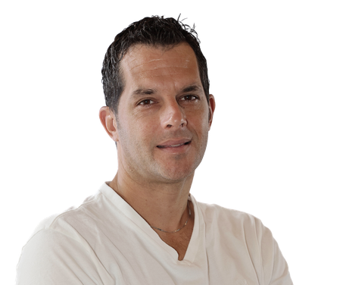
M25
Amir Gissin
CEO MWU
Assaf Goren
Chairman Maccabiah
Orly Froman
Vice Chair MWU/M22
Galil Itzhaki
Director Maccabiah Headquarters
Roy Hessing
CEO Maccabiah
3

Slide 4
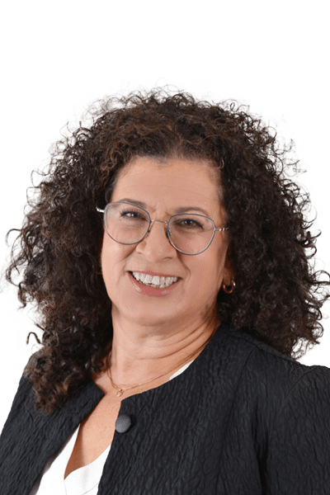
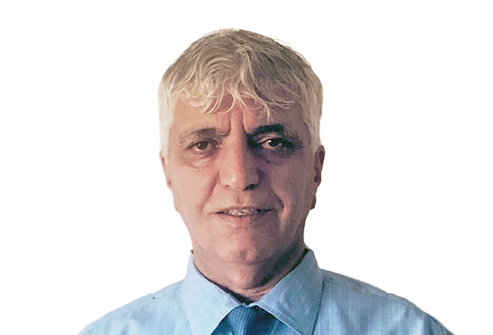
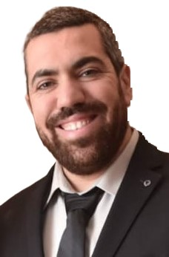
Operations
Sports
Benny Ben Ari
Director
Meni Itzhaki
Chair
Elad Simon
Director
Merav Olejnik
Chair
4

Slide 5
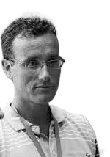
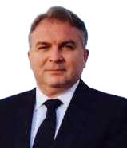
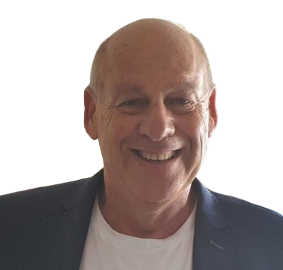
Accommodation
Transportation
Ami Elram
Director
Ofer Miranda
Chair
Tzemach Ichay
Director
Miki Adler
Chair
5

Slide 6
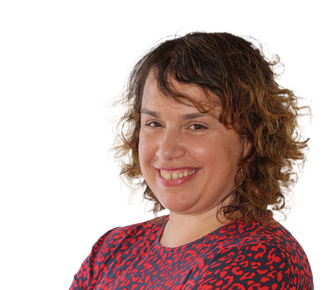
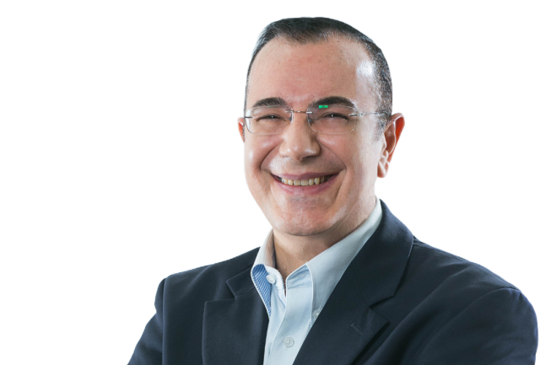
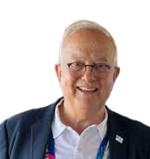
Education & Culture
Program Development
Osnat Zur
Director
Shirit Saks Haim
Chair
Rabbi Carlos A. Tapiero
Director
David Korenfeld
Chair
6

Slide 7
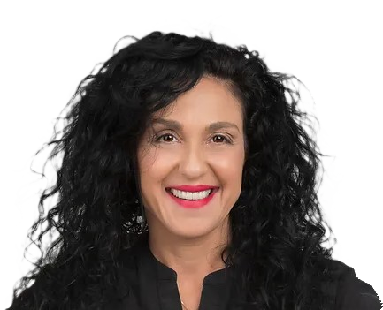
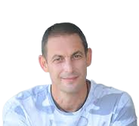
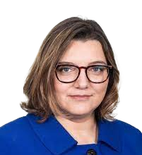
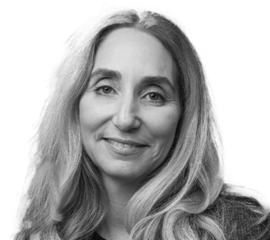
Marketing
Ceremonies & Events
Lilach Bar David
Director
Michal Dvoretsky
Chair
Eren Fisher
Director
Michal Frank
Chair
7

Slide 8
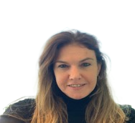
Human Resources
IT & Registration
Michal Magen
Director
Yehudit Grisaro
Chair
Nir Rapaport
Director
Jorge Steinfeld
Chair
8

Slide 9
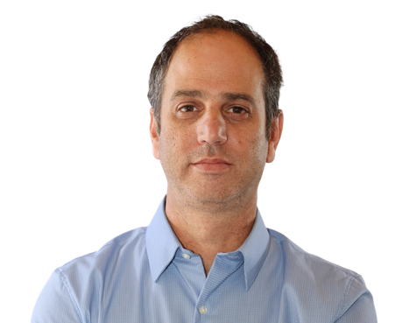
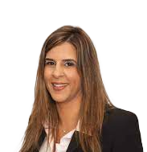
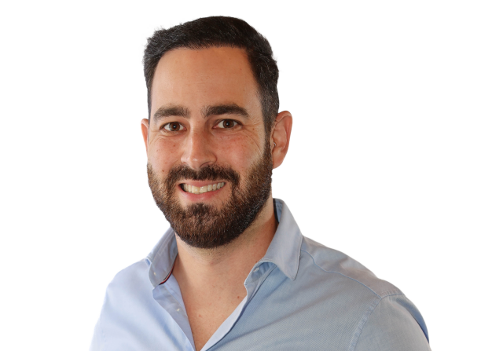
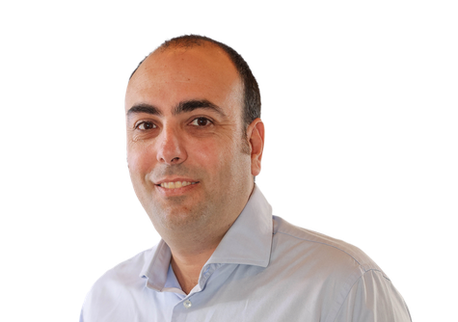
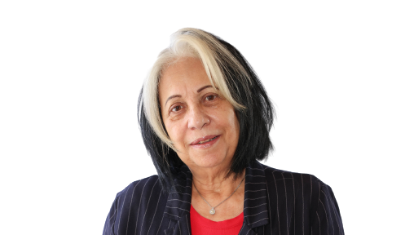
Finance
Legal
Tzachi Ashkenazi
Director
Doron Shitruk
Treasurer
Rinat Tsipori
Legal Adviser
Dor Or
Legal Adviser
Shay Ben-Harosh
Financial Controller
Rachel Lev Tzur
Accountant
9

Slide 10
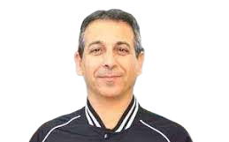
Small Communities
Liaison To IMC
Vice Chair MWU
Israel Delegation
Ministry of Culture & Sports
Asaf Stolarz
Chair
Riki Kanterewicz
Chair
Vered Atsmon
Chair
Avi Benbenisti
10

Slide 11
EF Schedule
EF1 Release – November 2023 Israeli Associations (1) – January 2024
EF1 - March 2024
EF2 Release – July 2024
EF2 - November 2024 Israeli Associations (2) – January 2025
Maccabiah Congress + EF3 March 2025
Israeli Associations (3) – June 2025
11
11

Slide 12
EF1 Sports
Sport | O | J | M
Archery | V
Athletics (Track & Field) | V | V
Badminton | V | V
Baseball |  | V
Basketball | V | V | V
Basketball 3*3 | V | V
Beach Football (Soccer) | V | V
Beach Volleyball | V | V
Sport | O | J | M
Beach Tennis | V | V
Breaking | V | V
Catchball | V
Chess | V | V
Cricket | V | V
Cycling (Mountain bike) | V
Cycling (Road) | V
Cycling (Time trial) | V
Cycling (Track) | V
Equestrian | V
12
12

Slide 13
EF1 Sports
Sport | O | J | M
Fencing | V | V | V
Field Hockey | V | V
Football (Soccer) | V | V | V
Futsal | V | V | V
Golf | V | V | V
Gymnastics (Artistic) | V | V
Gymnastics (Rhythmic) | V | V
Handball | V
Ice Hockey | V | V | V
Sport | O | J | M
Judo | V | V | V
Karate | V | V | V
Lawn Bowls | V
Maccabi-Man/Woman | V
Motocross | V
Netball | V | V | V
Ninja | V | V
Padel | V |  | V
Pickleball | V
13
13

Slide 14
EF1 Sports
Sport | O | J | M
Rugby | V | V
Rugby 7's | V | V
Softball | V | V | V
Rugby | V | V
Sport Climbing (Bouldering) | V | V
Squash | V | V | V
Super Enduro | V
Surfing | V
Swimming | V | V | V
Table Tennis | V | V | V
Sport | O | J | M | P
Taekwondo | v | V
Tennis | V | V | V
Volleyball | V | V | V
Water Polo | V | V
Weightlifting | V
Wrestling | V | V
Para Cycling |  |  |  | V
Para Swimming |  |  |  | V
Para Table Tennis |  |  |  | V
Wheelchair Basketball |  |  |  | V
Wheelchair Tennis |  |  |  | V
14
14

